Slide 1
What’s an ERD Diagram?

Slide 2
ERD
Entities (Tables) – The objects that store data, like "Customers" or "Orders."
Attributes (Columns) – The properties or fields of each entity.
Relationships – How entities relate to one another, such as "one-to-many" or "many-to-many."

Slide 3
Steps to ERD for DB
Identify Entities (Tables): Write down all the tables in your PostgreSQL schema.
Identify Attributes (Columns): List the important columns in each table, including primary keys, foreign keys, and other significant fields.
Identify Relationships: Define how the tables are connected, such as one-to-one, one-to-many, or many-to-many relationships

Slide 4
ER Diagram one-to-one, one-to-many, and many-many.
A one-to-one example would be one student associated with one mailing address.
A one-to-many example (or many-to-one, depending on the relationship direction): One student registers for multiple courses, but all those courses have a single line back to that one student.
Many-to-many example: Students as a group are associated with multiple faculty members, and faculty members in turn are associated with multiple students.

Slide 5
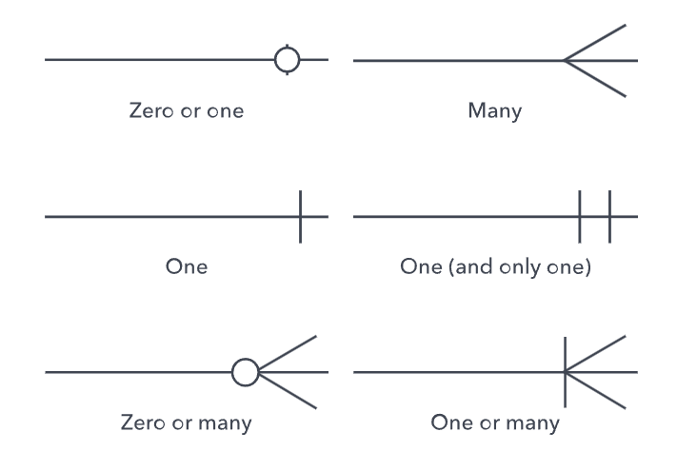
Visual Representation

Slide 6
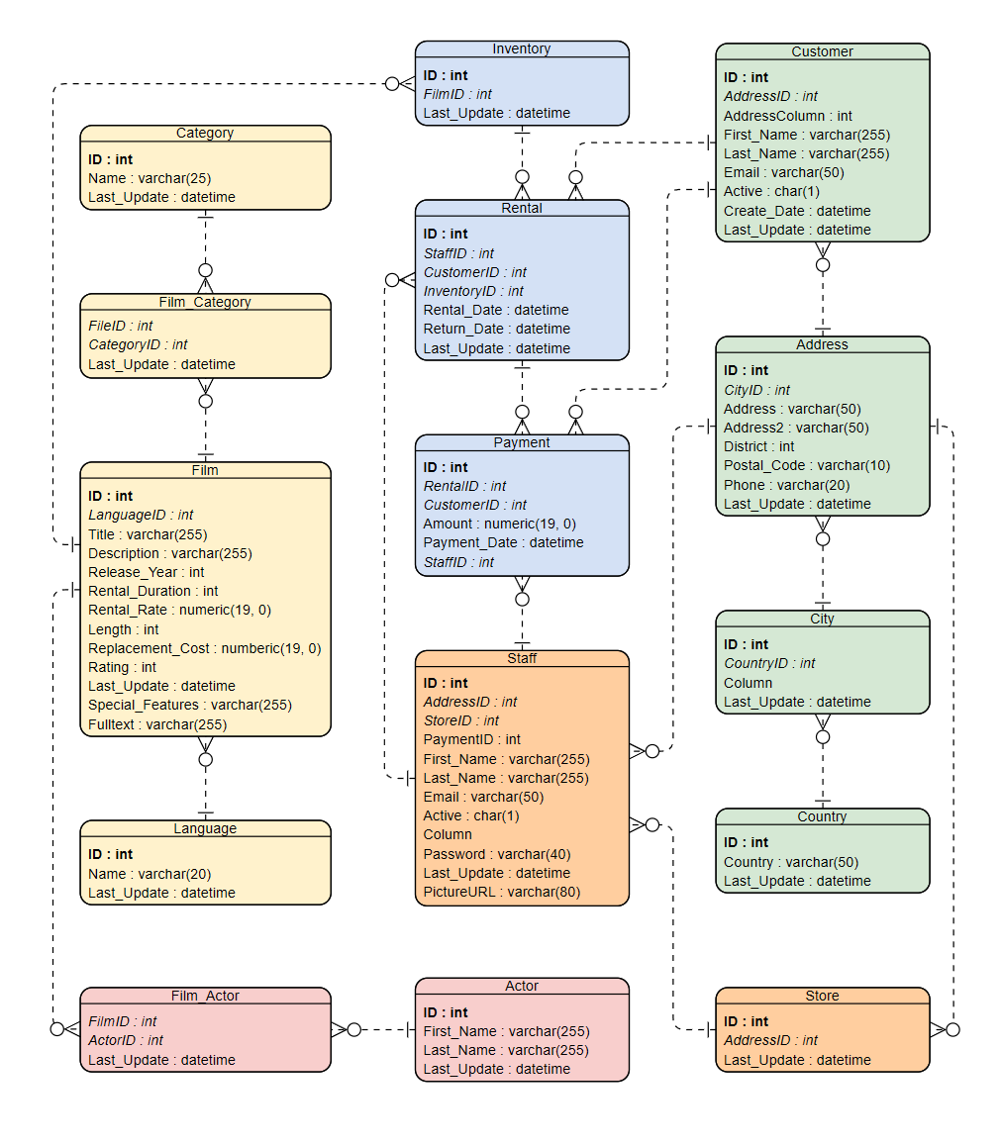
Notes:
https://online.visual-paradigm.com/app/diagrams/#diagram:proj=0&type=ERDiagram&gallery=/repository/8d0b0c2d-1963-4997-b95a-aca38976851a.xml&name=Entity%20Relationship%20Diagram%3A%20Movie%20Rental%20System

